Slide 1
WELCOME

Slide 2
Online Examination system
prepared by : Anup pokhrel

Slide 3
Introduction
Online examination system is a computer system which is used to take exam by using computer
It is a web-based application
It can be conducted through internet and intranet
It can replace a paper-based exam in future

Slide 4
Objectives
Create web-based application which can be used to take online exam
To replace a paper-based examination system
Use MySQL I database server to create secure database for the system

Slide 5
Scope
Online Examination System is designed for educational institutes to conduct logical test.
It is a web-based application so, it can be used from anywhere
Easy to conduct examination
No need of examiner to conduct exam
It saves money and time

Slide 6
Objectives
To develop an E-commerce web application
To study about the E-commerce market in our country.
To study and follow the principals of System development lifecycle.
To design and developed a user-friendly system.
To allows a user to perform a CRUD function properly.
To provide an easy service to the customers
To increase the market and revenue.
To increase usability and customer experience

Slide 7
Features
Secure
Easy to use
Accurate
Need less human resource
Generate result automatically and quickly

Slide 8
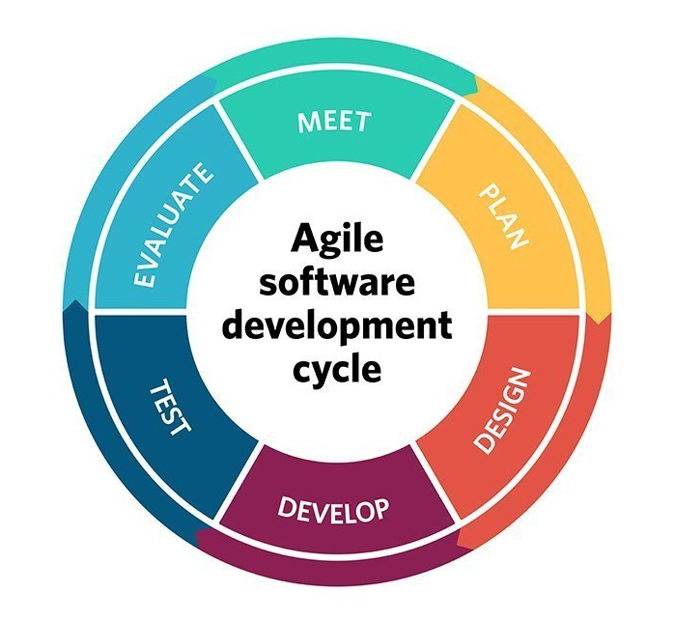
System Development life cycle
Agile Development Methodology

Slide 9
Programming language
PHP (Object oriented programming language)
MySQL
HTML/CSS
JavaScript
Bootstrap

Slide 10
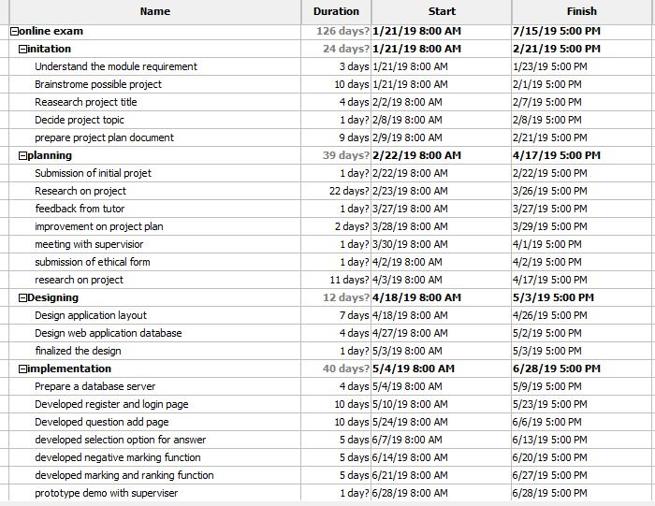
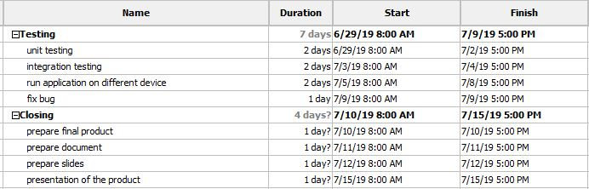
Planning
Gantt chart

Slide 11
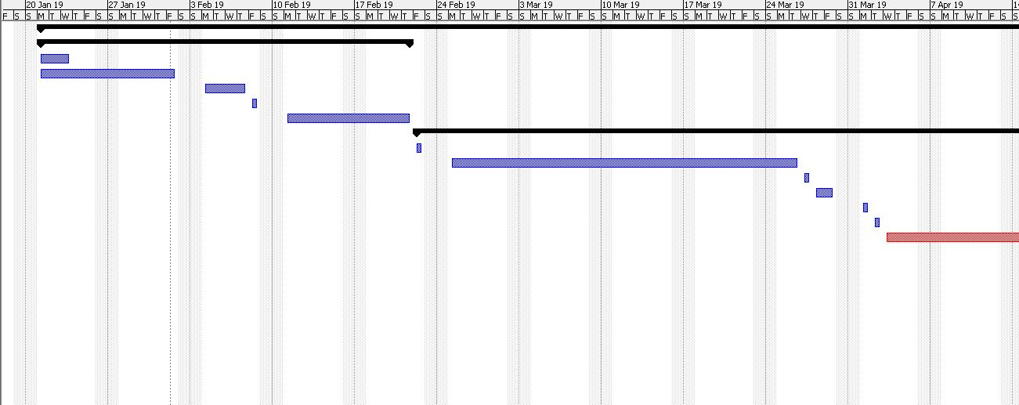
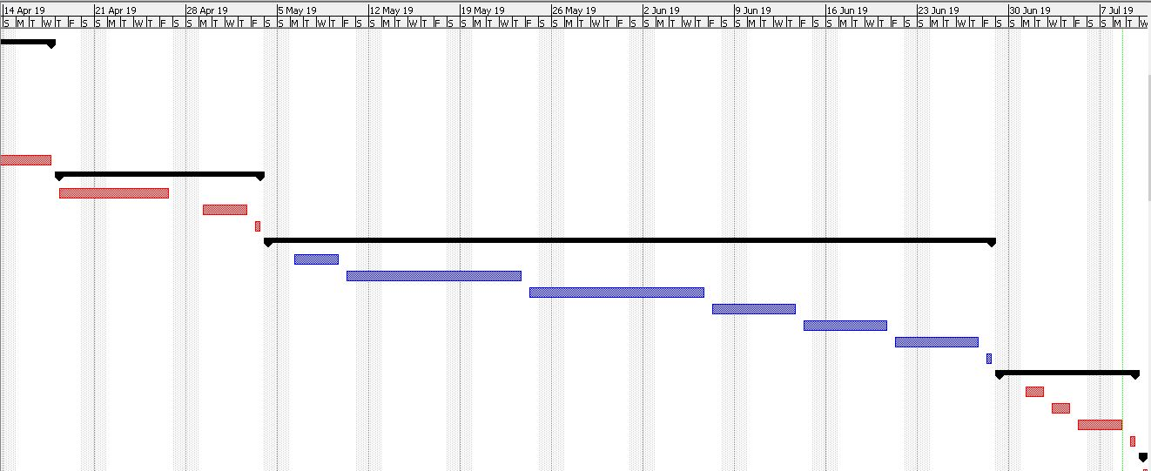
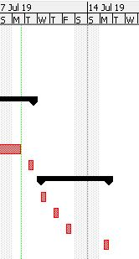
Planning Gantt chart

Slide 12
Design Flowchart Flow chart of Online Examination System

Slide 13
Design Entity relationship diagram

Slide 14
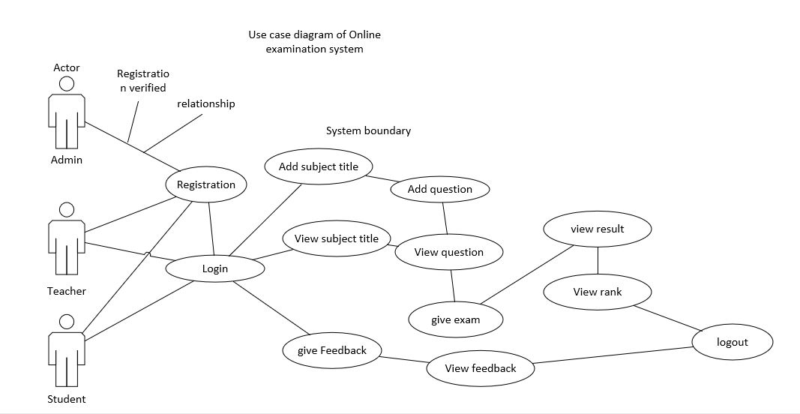
Design Use case diagram

Slide 15
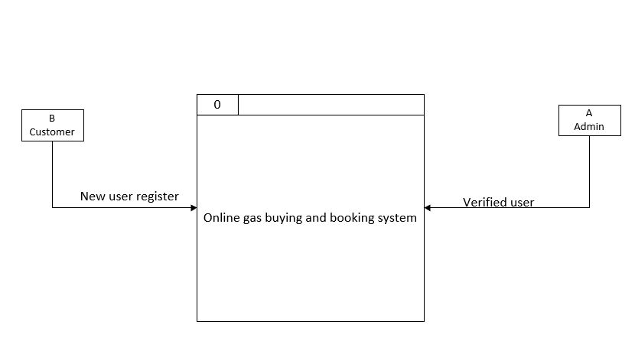
Design Level 0 Data flow diagram

Slide 16
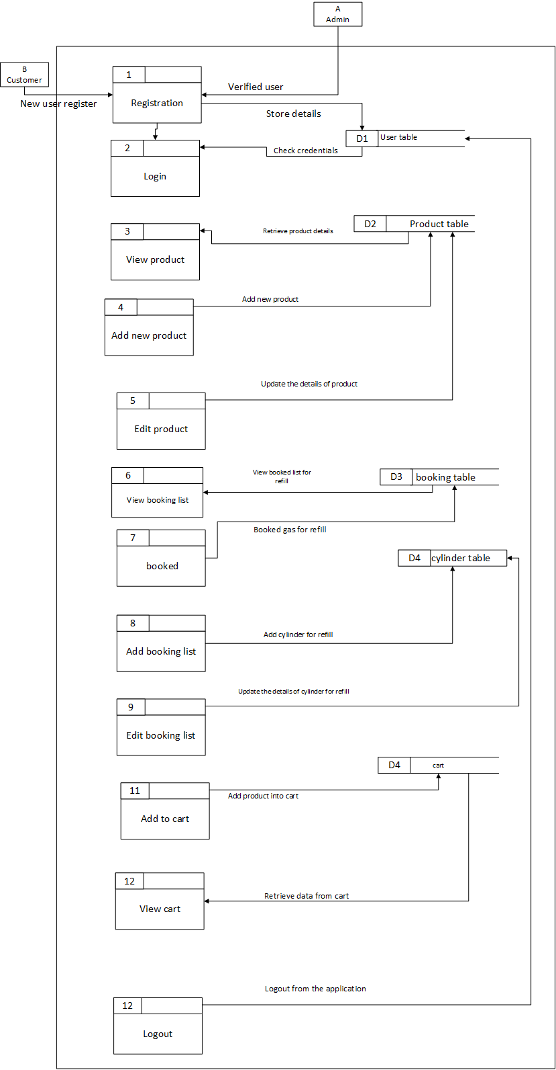
Design Data flow level 1 diagram

Slide 17
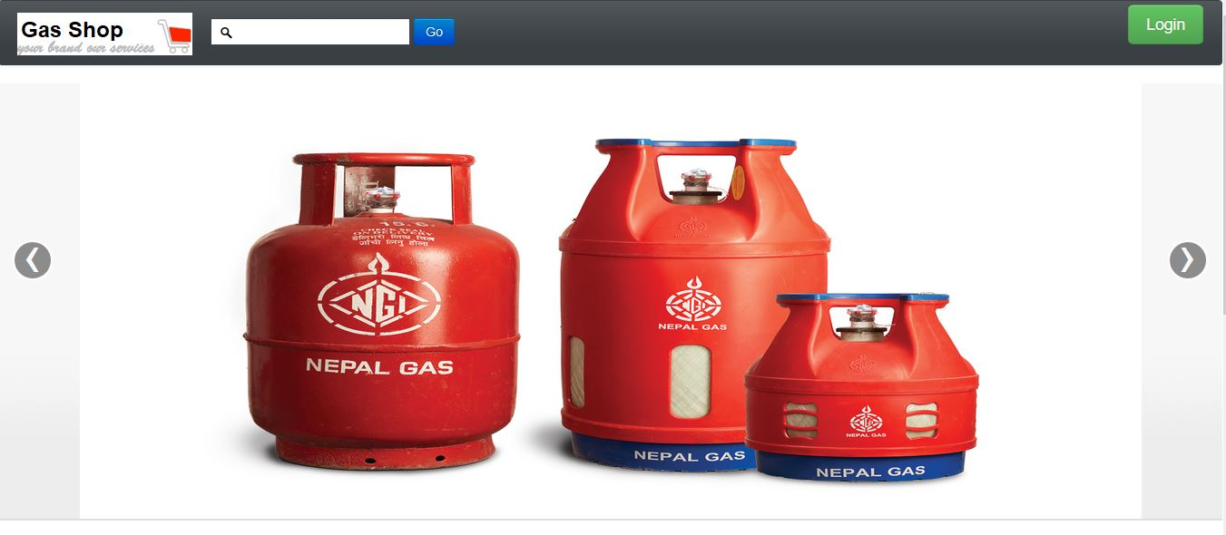
Implementation Home page

Slide 18
Testing
White box testing
Need skillful tester.
Check the internal functionality of the system

Slide 19
Future work
E-payment system
Delivery and GPS tracking system
Mobile application
Include assistive technology (Screen readers, screen magnification software)

Slide 20
Any question

Slide 21
Thank you

